Slide 1

Content Based Image Retrieval
Project Guide
Sri. K. Narasimha Raju
BY
Gudena Dileep
K Abhinav
Edukulla Harish
Reyya Shiva Kumar

Slide 2
Introduction
CBIR or Content Based Image Retrieval is the retrieval of images based on visual features such as color, texture and shape.
In CBIR, each image that is stored in the database has its features extracted and compared to the features of the query image. It involves two steps.
• Feature Extraction The first step in the process is extracting image features to a distinguishable extent.
• Matching The second step involves matching these features to yield a result that is visually similar.

Slide 3
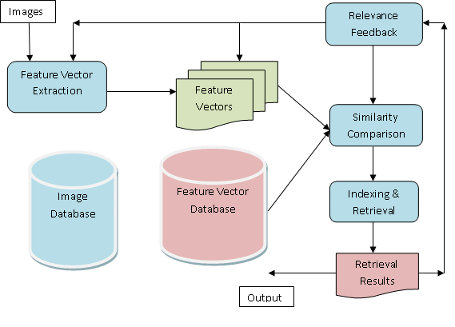
Feature Extraction

Slide 4
Feature Representations in this project
Color Histogram
Color Coherence Vector

Slide 5
Color Histogram
A color histogram H is a vector <h1, h2,….., hn> in which each color bucket hj contains the number of pixels of color j in the image.
Typically images are represented in the RGB color space, and a few of the most significant bits are used from each color channel.
For a given image I, the color histogram HI is a compact summary of the image. A database of images can be queried to find the most similar image to I, and can return the image I’ with the most similar color histogram HI’.

Slide 6
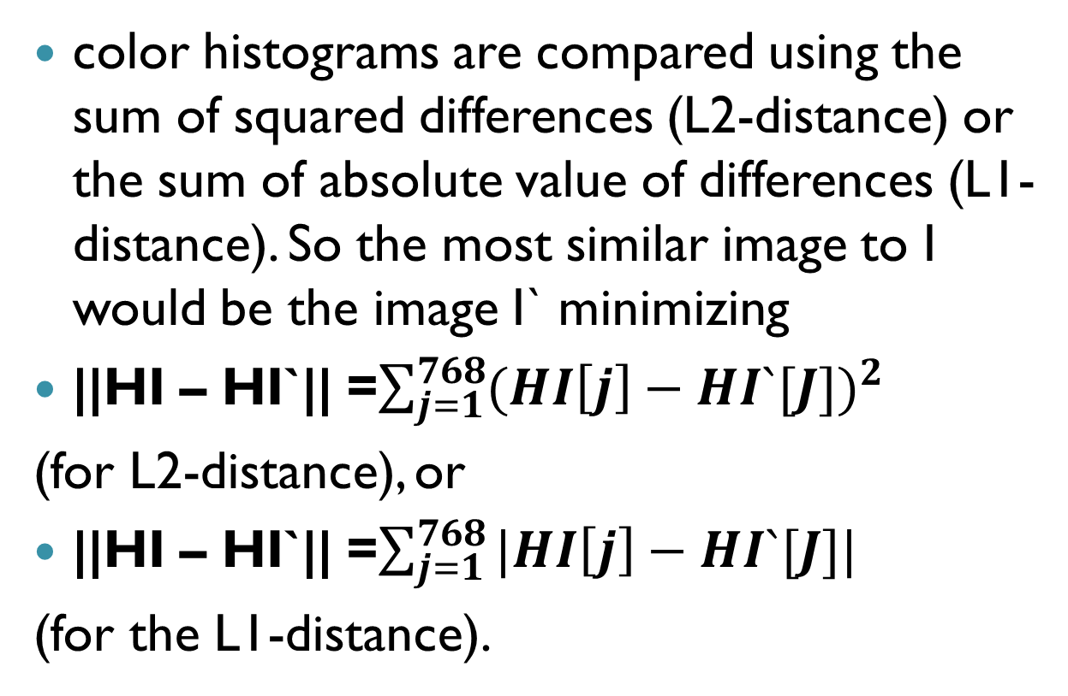
Comparing images using color histogram
color histograms are compared using the sum of squared differences (L2-distance) or the sum of absolute value of differences (L1-distance). So the most similar image to I would be the image I` minimizing
||HI – HI`|| =$\sum_{j=1}^{768}{{(HI\left[j\right]−HI`[J])}^{2}}$
(for L2-distance), or
||HI – HI`|| =$\sum_{j=1}^{768}{|HI\left[j\right]−HI`[J]|}$
(for the L1-distance).

Slide 7
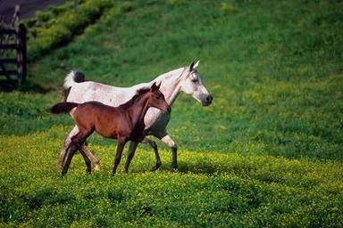
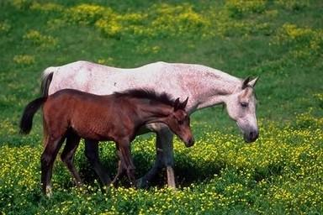
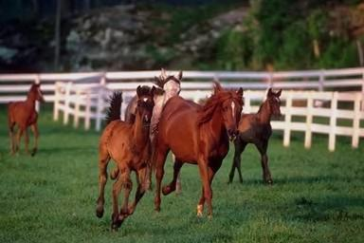
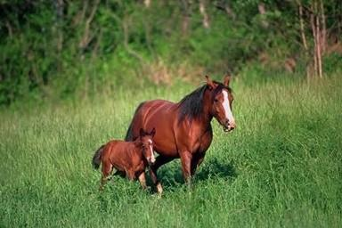
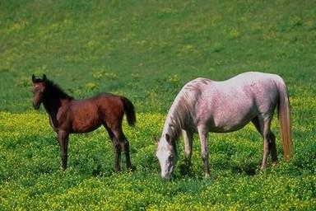
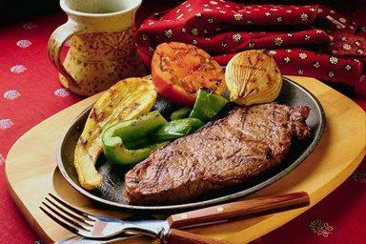
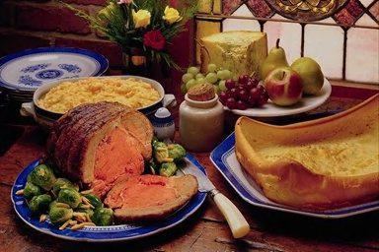
Color Histogram(cont.)
Test image
Result images

Slide 8
Color Coherence Vector (CCV)
Color coherence method is a histogram-based method for comparing images that incorporates spatial information.
In color coherence process, each pixel is classified into a given color bucket as either coherent or incoherent, based on whether or not it is part of a large similarly-colored region.
A color coherence vector (CCV) stores the number of coherent versus incoherent pixels with each color.

Slide 9
CCV(cont.)
Color coherence is the degree to which pixels of that color are members of large similarly-colored regions.
We refer to these significant regions as coherent regions, and observe that they are of significant importance in characterizing images.
By separating coherent pixels from incoherent pixels, CCV's provide finer distinctions than color histograms.

Slide 10
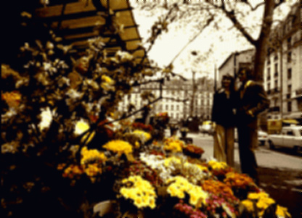
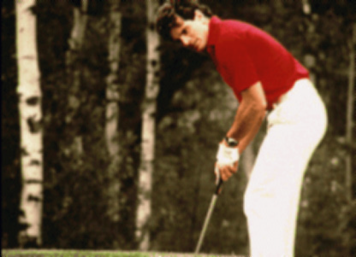
CCV (cont.)
Two images with similar color histogram but looks different.

Slide 11
CCV (Cont.)
The color red appears in both images in approximately the same quantities. In the left image the red pixels (from the flowers) are widely scattered, while in the right image the red pixels (from the golfer's shirt) form a single coherent region.

Slide 12
Computing CCV
First blur the image slightly by replacing pixel values with the average value in a small local neighborhood (currently including the 8 adjacent pixels. )This eliminates small variations between neighboring pixels.
Discretize the color space, such that there are only n distinct colors in the image.(256 colors to 64 colors)

Slide 13
Computing CCV(Cont.)
A coherent pixel is part of a large group of pixels of the same color, while an incoherent pixel is not. Pixel groups are determined by computing connected components.
A connected component C is a maximal set of pixels such that for any two pixels p; p0 in C, there is a path in C between p and p0.

Slide 14
Computing CCV(Cont.)
Pixels are classified as either coherent or incoherent depending on the size in pixels of its connected component.
A pixel is coherent if the size of its connected component exceeds a Ƭ value ; otherwise, the pixel is incoherent.
A region is classified as coherent if its area is about 1% of the image size.(Ƭ)

Slide 15
Computing CCV(example)
We demonstrate the computation of CCV with an example . To keep our example small, we will let T = 4 and assume that we are dealing with an image in which all 3 colour components have the same value at every pixel (in the RGB colour space this would represent a grayscale image).
This allows us to represent a pixel's colour with a single number (i.e., the pixel with R/G/B values 12/12/12 will be written as 12).

Slide 16
Computing CCV(example cont.)
After blurring the input image, the resulting intensities are as follows.
Matrix representing intensities
22 10 21 22 15 16
24 21 13 20 14 17
23 17 38 23 17 16
25 25 22 14 15 21
27 22 12 11 21 20
24 21 10 12 22 23

Slide 17
Computing CCV(example cont.)
Let us discretize the colour space so that bucket 1 contains intensities 10 through 19, bucket 2 contains 20 through 29, bucket 3 contains 30-39. Then after discretization we obtain the image matrix as follows.
Matrix after discretization
2 1 2 2 1 1
2 2 1 2 1 1
2 1 3 2 1 1
2 2 2 1 1 2
2 2 1 1 2 2
2 2 1 1 2 2

Slide 18
Computing CCV(example cont.)
The next step is to compute the connected components. Individual components will be labelled with letters and we will need to keep a table which maintains the discretized colour associated with each label, along with the number of pixels with that label. Of course, the same discretized colour can be associated with different labels if multiple contiguous regions of the same colour exist. The image may then become
Coherent and incoherent pixels.
B C B B A A
B B C B A A
B C D B A A
B B B A A E
B B A A E E
B B A A E E

Slide 19
Computing CCV(example cont.)
LABEL | A | B | C | D | E
COLOR | 1 | 2 | 1 | 3 | 2
SIZE | 12 | 15 | 3 | 1 | 5
LABEL | A | B | C | D | E
The components A, B, and E have more than Ƭ pixels, and the components C and D less than pixels. Therefore the pixels in A;B and E are classified as coherent, while the pixels in C and D are classified as incoherent. The CCV for this image will be
COLOR | 1 | 2 | 3
COHERENT | 12 | 20 | 0
IN-COHERENT | 3 | 0 | 1

Slide 20
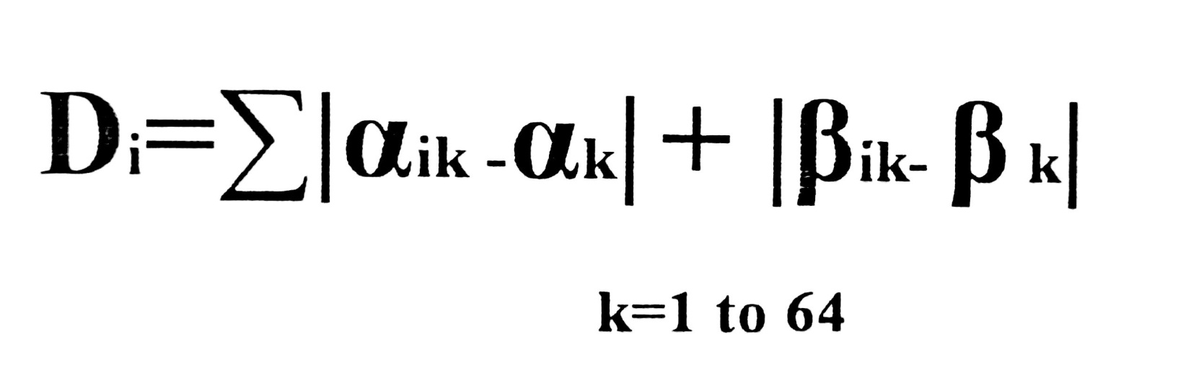
Comparing CCV values.
Manhattan Distance Formula

Slide 21
Comparing CCV values(cont.)
For each color we have a vector like this:
for r in range(64):
for g in range(64):
for b in range(64):
ccv[str(r)+str(g)+str(b)]=
<(α,β),(α,β),(α,β),(α,β)……(α,β)>
(r:g:b)= <(α,β),(α,β),(α,β),(α,β)……(α,β)>
α -> COHERENT
β -> INCOHERENT

Slide 22
Backend
The backend is a database which is a combination of operating file system and RDBMS . Images and the extracted features are stored in a single table named `imgdata`.

Slide 23
Comparing CCV values(cont.)
For every image in the database we have a field `key` and `vector`.
According to the images retrieved from the color histogram we retrieve their respective keys and vectors.
These keys and vectors are stored into a dictionary data structure which is compared with input image’s dictionary using Manhattan's distance formula.

Slide 24
Backend(cont.)
Field | Type | Null | Key | Default
Images | LongBlob | No |  | NULL
Colhist | Varchar(5000) | No |  | NULL
Id | Int(11) | No | Yes | NULL
Key | LongText | No |  | NULL
Vector | LongText | No |  | NULL

Slide 25
Applications of CBIR
Crime Prevention: Automatic face recognition systems, used by police forces.
Security Check: Finger print or retina scanning for access privileges.
Medical Diagnosis: Using CBIR in a medical images to aid diagnosis by identifying similar past cases.
Intellectual Property: Trademark image registration, where a new candidate mark is compared with existing marks to ensure no risk of confusing property ownership.

Slide 26
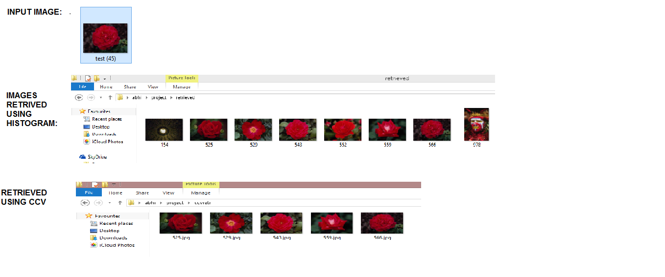
Test cases

Slide 27
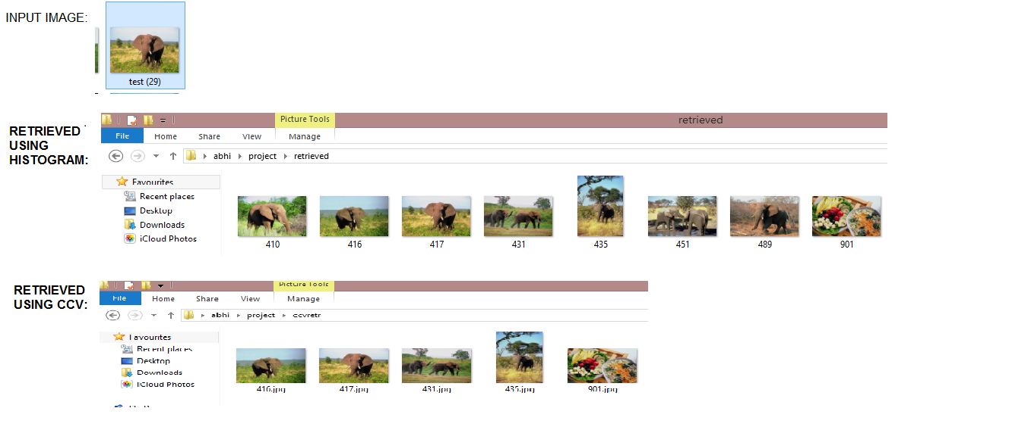
Test cases(cont.)

Slide 28
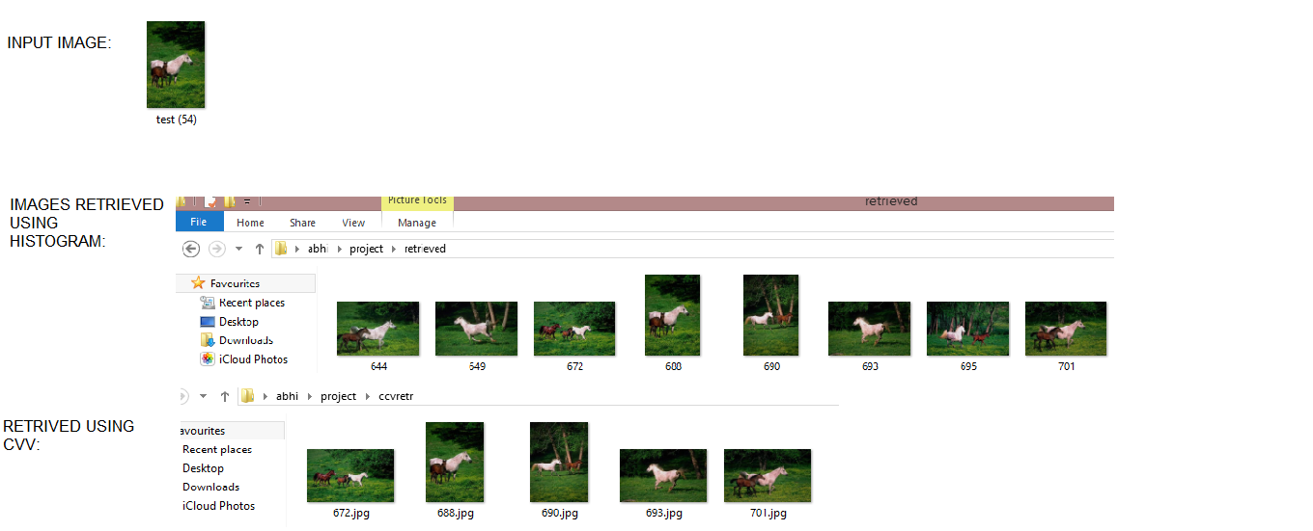
Test cases(cont.)

Slide 29
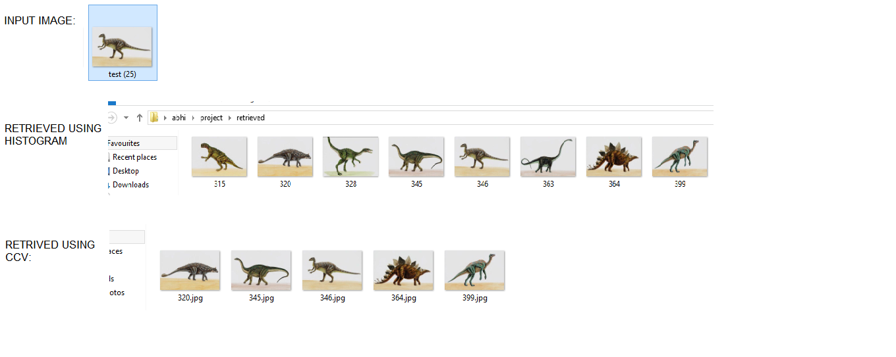
Test cases(cont.)

Slide 30
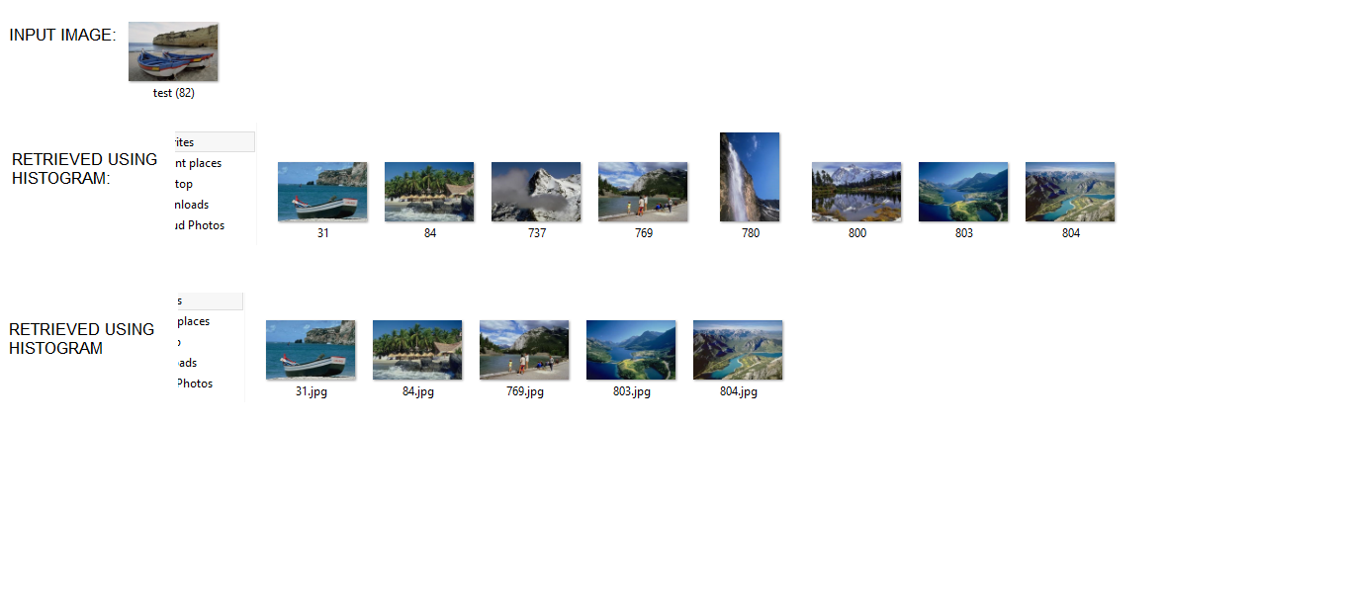
Test cases(cont.)

Slide 31







Test image
Retrieved
Thank You

